Slide 1
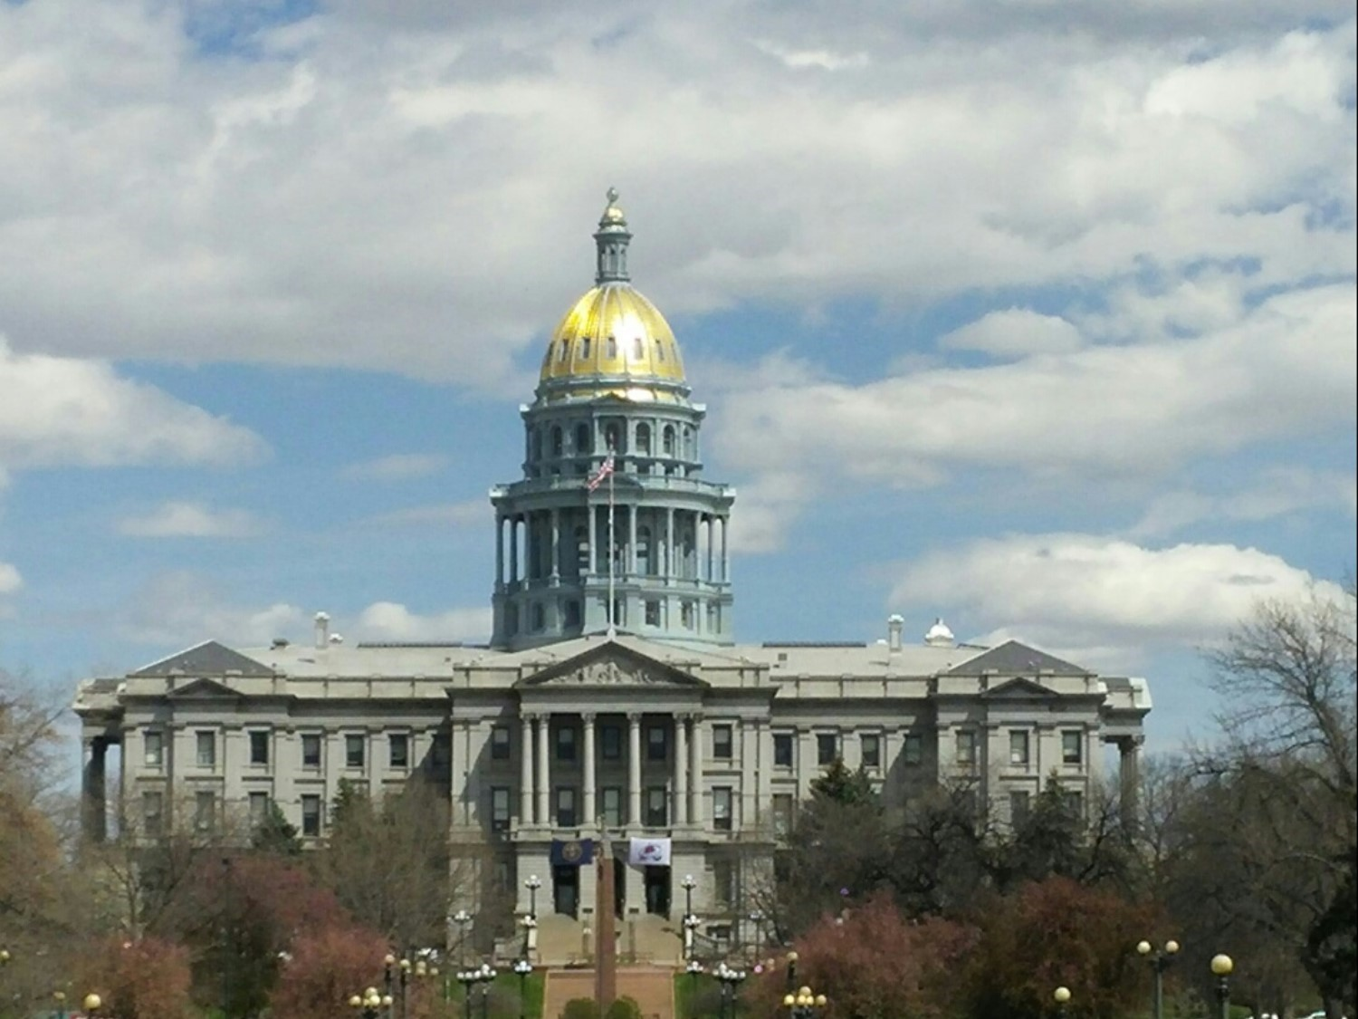
Presentation for Colorado Association of School Boards (CASB)
February 21, 2025
Kristine Reynolds
Campaign Finance Trainer

Slide 2

Colorado campaign and political finance (CPF)
School Board Candidates and Committees

Slide 3
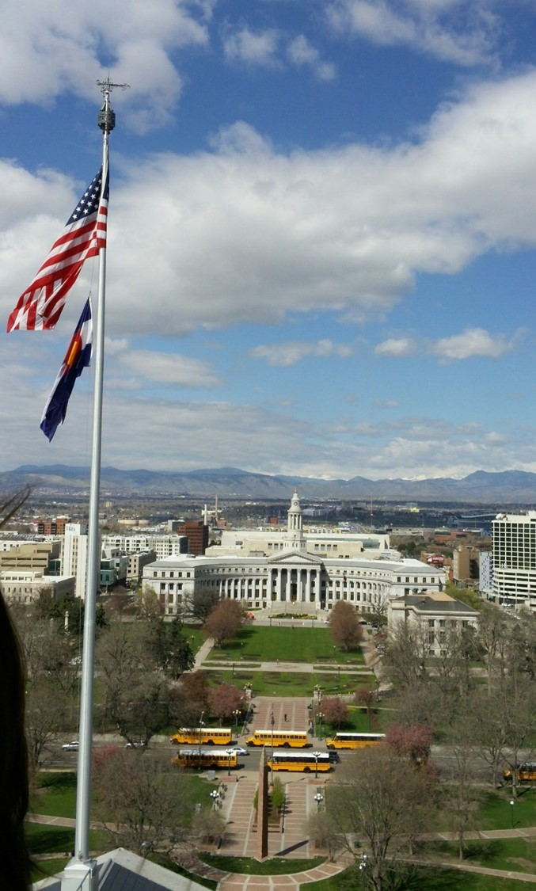
DISCLAIMER
The Colorado Secretary of State’s office does not provide legal advice.
This training was created for reference purposes only.
Information contained in the training is not a substitute for legal advice and actual knowledge of campaign finance laws and regulations.

Slide 4
Resources
Campaign Finance page on Secretary of State’s (SOS) website
TRACER (Transparency in Contribution and Expenditure Reporting) website
Colorado Campaign and Political Finance Manual – includes the laws and rules
  Article XXVIII of the Colorado Constitution,
  Title 1, Article 45 of the Colorado Revised Statute (a.k.a. the Fair Campaign Practices Act), and
  Rules Concerning Campaign and Political Finance

Slide 5
Resources Continued
Training Opportunities – SOS training page
  Online eLearning's (CPF 101)
  TRACER Webinars (Learn how to use TRACER)
  Lawn Chair Chats – Informal discussions, via TEAMS and/or Zoom, to discuss Colorado’s Campaign Finance laws/rules and TRACER.
Campaign Finance Support Help Desk
  Phone: 303-894-2200 (Dial 3, then 1) or extension 6383.
  Email: CPFhelp@coloradosos.gov

Slide 6

Topics for discussion
Standalone candidate v. candidate committee
Filing schedules
Disclosure of activity (contributions & expenditures)
Disclaimers / Paid for by Statements
Penalties, Waivers, & Complaints
Closing / Terminating a committee
TRACER

Slide 7

You become a candidate when
You publicly announce an intention to seek election to public office
And then
Receive a contribution or make an expenditure on behalf of the candidacy
Within 10 calendar days of becoming a candidate you must file a Candidate Affidavit
Public Announcement Definition
Registering a candidate committee, or
Announcing an intention to seek public office through:
  A speech, advertisement, or other communication reported or appearing in public media, or
  A statement made in any place accessible to the public, or
  A statement made in a manner that a reasonable person would expect it to become public.

Slide 8
Standalone candidate vs. candidate committee
Standalone Candidate
Candidate committee
A candidate who is self-funding their candidacy; not accepting contributions of any kind from anyone.
Files disclosure reports to show their expenditures for the campaign.
Only required to file reports for periods where expenditures take place.
A candidate who is accepting contributions to help fund their campaign.
Files disclosure reports to show their contributions and expenditures.
Must register prior to accepting any type of contribution.
Once registered all reporting (contributions/expenditures) is done under the committee.
Required to file all reports regardless of the level of activity.

Slide 9

Disclosure Report Due Dates (2025)
May 1, 2025
June 2, 2025
July 1, 2025
August 1, 2025
September 2, 2025
September 15, 2025
September 29, 2025
October 14, 2025
October 27, 2025
December 9, 2025
Visit the Filing Calendar page where you can download / print the calendar that includes the reporting periods for each report.

Slide 10

Disclosure Report Due Dates - Continued
A frequent schedule is required during years when the candidate’s office is on the ballot.
During years when the candidate’s office is not on the ballot, reports are due quarterly.
Reports are filed electronically through TRACER and are timely if filed BEFORE MIDNIGHT on the due date.

Slide 11

supplemental reporting periods
September 5, 2025 – Starts the 60-day Electioneering Communication period before the Biennial School Board Election and concludes on November 3, 2025. This information will be part of your standard reports.
October 5, 2025 – Starts the 30-day period before the election for 24-Hour Major Contributor reports and concludes on November 3, 2025. This is a separate report.

Slide 12
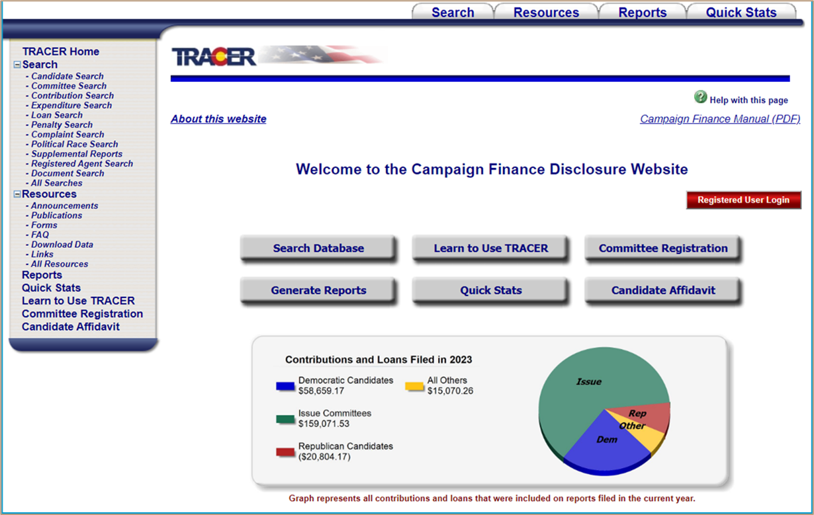
DISCLOSURE REQUIREMENTS
CONTRIBUTIONS
EXPENDITURES
SUPPLEMENT REPORTS
PAID FOR BY STATEMENTS

Slide 13

Prohibited contributors & contributions
Corporations (profit & non-profit)
Labor Organizations / Unions
Foreign Citizens
Foreign Governments
Foreign Corporations
Issue Committees
Small-Scale Issue Committees
Independent Expenditure Committees
Other Candidate Committees
Anonymous sources – contributions where the identity of the contributor is unknown or not all the required information is provided

Slide 14


Contributions
Must report all – including those under $20 (a.k.a. Non-Itemized)
$20 or more (aggregated or one-time), within a reporting period, must be itemized with:
  Contributor’s name & address, and
  Occupation & Employer, if from a natural person & the contribution is $100 or more
No cash or coin contributions over $100
Use Fair Market Value to report non-monetary (in-kind) contributions
Anonymous contributions may not be kept and must be donated to an IRS recognized charity or sent to the State Treasurer’s office within 30 days of receipt. (CPF Rule 10.8)
Select “Candidate” as the contributor type when a candidate contributes/loans to their own committee

Slide 15
school district director candidate committee – contribution limits
Contributor Type | Contribution Limit
Individual (Natural Person) Political Committee LLC or Business Entity (other than a corporation) Federal PAC Political Party Note: Other permissible contributors are treated like an Individual for limits. | $2,500 For the entire Election Cycle Note: There is no limit for how much a candidate may contribute / loan to their own candidate committee.
Small Donor Committee | $25,000 For the entire Election Cycle

Slide 16
Limited Liability company (LLC) Contributions
LLC contributions are allowed if:
  All the LLC members are permissible contributors,
  The LLC’s shares are NOT publicly traded,
  The LLC does not file their taxes like a corporation.
  See the training manual for more details on LLC contributions and how to report them.
LLC contributions must include an affirmation form that the LLC knows the contribution is permissible (see website for a sample form)
Must be itemized on report regardless of the amount contributed
For detailed requirements, please review 1-45-103.7 of the Colorado Revised Statutes (C.R.S.)

Slide 17

expenditures
Must report all – including those under $20 (a.k.a. Non-Itemized)
$20 or more (aggregated or one-time), within a reporting period, must be itemized
  Itemized means listing:
    Name & address to whom payment was made
    Purpose of expenditure
No cash or coin expenditures over $100
An expenditure is made when:
  The actual spending occurs OR
  A contractual agreement has been made and the amount is known - Whichever comes first
The law does not provide a list of permissible or prohibited types of expenditures. Funds can’t be used for personal purposes except as outline by 1-45-103.7(6.5), C.R.S. by candidates for reasonable and necessary child / dependent care expenses.

Slide 18
Supplemental reports
24-Hour Notice of Major Contributor Report
A Major Contribution is a one-time contribution, including those given by a candidate to their own candidate committee, of $1,000 or more received within 30 days before the Regular Biennial School election.
TRACER creates a report once a qualifying contribution has been entered/saved. These reports are due within 24 hours of the recorded received date. Note: Entered incorrect contribution date? Call for assistance. Updating a date on a major contribution may create multiple major contributor reports.

Slide 19
Supplemental reports Continued
Biennial School Electioneering Communication
Are communications, that may or may not use express advocacy, referring to one or more candidates for school board and are broadcasted, printed, mailed, delivered, or otherwise distributed within 60 days before the election.
When an expenditure is entered and flagged by a filer as meeting the criteria, TRACER prompts filer to provide additional details which includes: the name(s) of the candidate(s) mentioned in the communication, and the date(s) of communication, and the method of the communication.

Slide 20
Sign placement
CPF Laws/Rules do not address sign placement locations or time frames when signs may be put up and / or must be removed.
Before putting up your signs, you may wish to check with:
The city’s / county’s zoning or code enforcement office,
Colorado Dept. of Transportation (CDOT)
Homeowner Association (HOA)

Slide 21
“paid for by” statements
Disclaimer / “Paid for By” statements are required for the following types of communications:
Broadcast & Non-Broadcast
Mailed
Printed
Delivered
Placed on a website
Streaming media service
Online forum for a fee
Note: TV & Radio Ads / “Paid for By” statements must comply with the Federal Communications Commission (FCC) Sponsorship Identitarian or “Sponsored by” regulations.
Did you know about, or have you read through the Secretary of State’s Guidance on Disclaimer Statements document?
No? Then click here or visit the Campaign Finance page of the SOS website.

Slide 22
“Paid for by” statements – Communication types
Electioneering Communications | Independent Expenditures | Other Communications
Spends $1,000 or more, in the aggregate during a calendar year, on Electioneering Communications | Spends in excess of $1,000 on an Independent Expenditure Communication in the calendar year | Spend in excess of $1,000 on a communication that must be disclosed under Article XXVIII of the Colorado Constitution or the Fair Campaign Practices Act – C.R.S. 1-45-108.3(1)

Slide 23




“Paid For By” Statements – Non-Broadcast Communications
Including Online Communications
Must appear in a manner that is clear, conspicuous, and is clearly readable, A statement that “The communication has been paid for by (full name of the person paying for the communication)”, Name of the natural person who is the registered agent if the person that paid for the communication is not a natural person, For an Independent Expenditure, a specific statement that the communication is not authorized by any candidate, Font is no less than 15 percent of the largest font used in the communication. If 15 percent is less than 8-point font, then the font must be 8-point font.

Slide 24





“Paid For By” Statements – Broadcast communications
Broadcast Communications including Online Video and Audio
Must comply with the Federal Communications Commission (FCC) for size, duration and placement. Click here to visit the FCC website for their requirements. A statement that “The communication has been paid for by (full name of the person paying for the communication)”

Slide 25
“Paid For By” Statements – Electronic & Online Communications
Electronic or Online Communications
If impracticable to include a disclaimer on an electronic or online communication, the required disclaimer must be available by means of a direct link from the communication to a web page or application screen containing the disclaimer statement.
Direct link disclaimer requirements:
  Same as the Non-Broadcast communication requirements for size and content,
  The information on the direct link must be clearly and conspicuously displayed and must be immediately apparent on the screen without receiving or viewing any additional material.

Slide 26
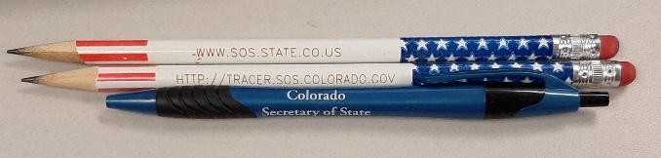


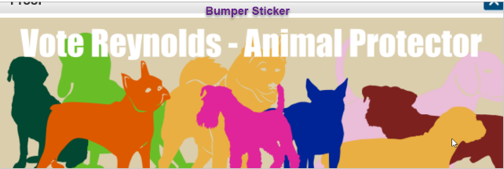
“Paid For By” Statements - Small Items
Campaign and Political Finance Rule 22
A disclaimer / paid for by statement does not apply to bumper stickers, pins, buttons, pens, and similar small items upon which the disclaimer cannot be reasonably printed.

Slide 27
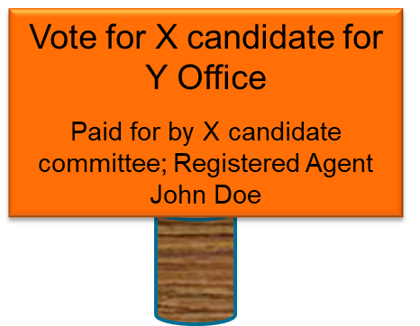
Complaint alert
One of the most common complaints we get is related to missing or incomplete “Paid for by” / Disclaimer statements. Please review 1-45-108.3 and 1-45-107.5(5), C.R.S. and CPF Rule 22.
A good “Paid for by” / Disclaimer statement is a complete one.

Slide 28

Penalties, Waivers,
&
Complaints

Slide 29
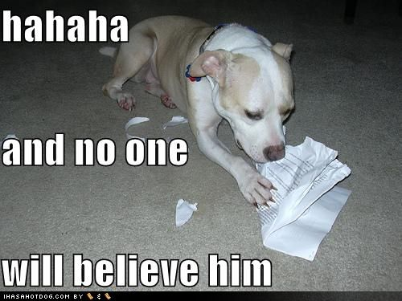
Penalties & waiver requests
Imposed Penalties
Appealing Penalties
Penalties of $50 per day, including weekends and holidays, are imposed every day a report is late. This includes the day of filing.
Once a penalty is imposed you have 30 days to file a written appeal through your TRACER account or by email.
A penalty may be reduced or waived if good cause is shown. See CPF Rule 18.1 for guidance.
But the dog ate my check book

Slide 30
Complaints
The process is established by Colorado law 1-45-111.7 C.R.S.
Anyone who believes a violation of Colorado CPF laws has occurred can file a complaint
Anonymous complaints are not permitted
Complaints are public information
Complainants are not a party to the proceedings
Complaints may be initiated by the Election Division’s Complaint & Enforcement unit
Note: The Complaint & Enforcement unit is separate from the Campaign Finance Compliance & Guidance team and may be reached at CPFcomplaints@coloradosos.gov or 303-894-2200 ext. 6338.

Slide 31
Complaints – Filing Guidelines
Must use the Campaign and Political Finance Complaint form
Identify a complainant (who is filing the complaint) and a respondent (who the complaint is against),
Must be filed within 180 days of when you knew or should have known of the alleged violation,
Allege one or more violations of campaign finance laws / rules
State sufficient facts to support a legal and factual basis for the complaint

Slide 32
Complaint process & outcomes
Initial filing & notification to all parties involved
Cure - respondent’s opportunity to respond and / or fix alleged violation(s)
Investigation
Dismissal
Administrative hearing
  Outcome could range from dismissal to a monetary penalty if a violation is found
IMPORTANT: Please review and address TRACER audit warnings when filing as they can be the basis for the Enforcement Unit to initiate an enforcement action(s).

Slide 33
Often filed types of complaints – CPF Rule 10.11
10.11 Cost-sharing by candidates
  10.11.1 Each candidate, standalone candidate, and candidate committee that shares any cost or expense including brochures, communications, advertisements, office space, or other overhead must pay its proportionate share of the cost within 30 days of the date the cost was incurred. The committee or candidate that made the expense must report the entire amount as an expenditure. The committee or candidate reimbursing for the expense must reimburse within 30 days and report their portion of the expense as an expenditure, and the reimbursed committee or candidate must report reimbursement payments as a returned expenditure.
  10.11.2 A committee nor candidate need not report discounts resulting from shared expenses as contributions given by a vendor or others on a purchase solely because more than one committee is cost-sharing with another committee.
  10.11.3 If a “paid for by” disclaimer is needed for any shared communication, the names of all of the committees or candidates must be included on the communication.

Slide 34


Unexpended Funds & Termination of TRACER Account

Slide 35
Unexpended funds – use of leftover funds
Candidate committees
Permissible uses
  Retain for use in a subsequent election (CPF Rule 2.2.4),
  Reimburse candidate for their expenditures,
  Contribute to the political party (subject to limits),
  Return to contributors (no more than what was contributed),
  Donate to a charitable organization recognized by the IRS, and
  Review 1-45-106 C.R.S. for additional options.
Personal use prohibited
  Candidates may be reimbursed for reasonable and necessary child / dependent care expenses incurred in connection with campaign activity during the election cycle.

Slide 36
Terminating / closing your TRACER accounts
Having a zero balance or losing an election does NOT automatically terminate your TRACER account. Candidates / committees MUST continue to file reports until the candidate or agent terminates by selecting the termination option on a regularly scheduled report.
When to terminate (1-45-103.7(12) & 1-45-106(1)(a)(III), C.R.S.):
If elected, must terminate candidate committee within one year of leaving office.
If unelected, must terminate within one year of the election.

Slide 37
How to terminate
Candidate Committee
Standalone candidate
Must have a zero balance,
May NOT have an outstanding debts / obligations (including penalties imposed by the SOS office), and
No open and / or unresolved complaints.
Use the next regularly scheduled report. Select the “Yes” radio button when asked if you're terminating. Answer prompt questions, click on File, click “Ok” to confirm.
File all expenditures / reports,
May NOT have any outstanding debts / obligations (including penalties imposed by the SOS office), and
No open and / or unresolved complaints.
Go to your Administration Tab, locate the Terminate button, read the requirements, if you meet the requirements click the Terminate button, and click “OK” to confirm.

Slide 38
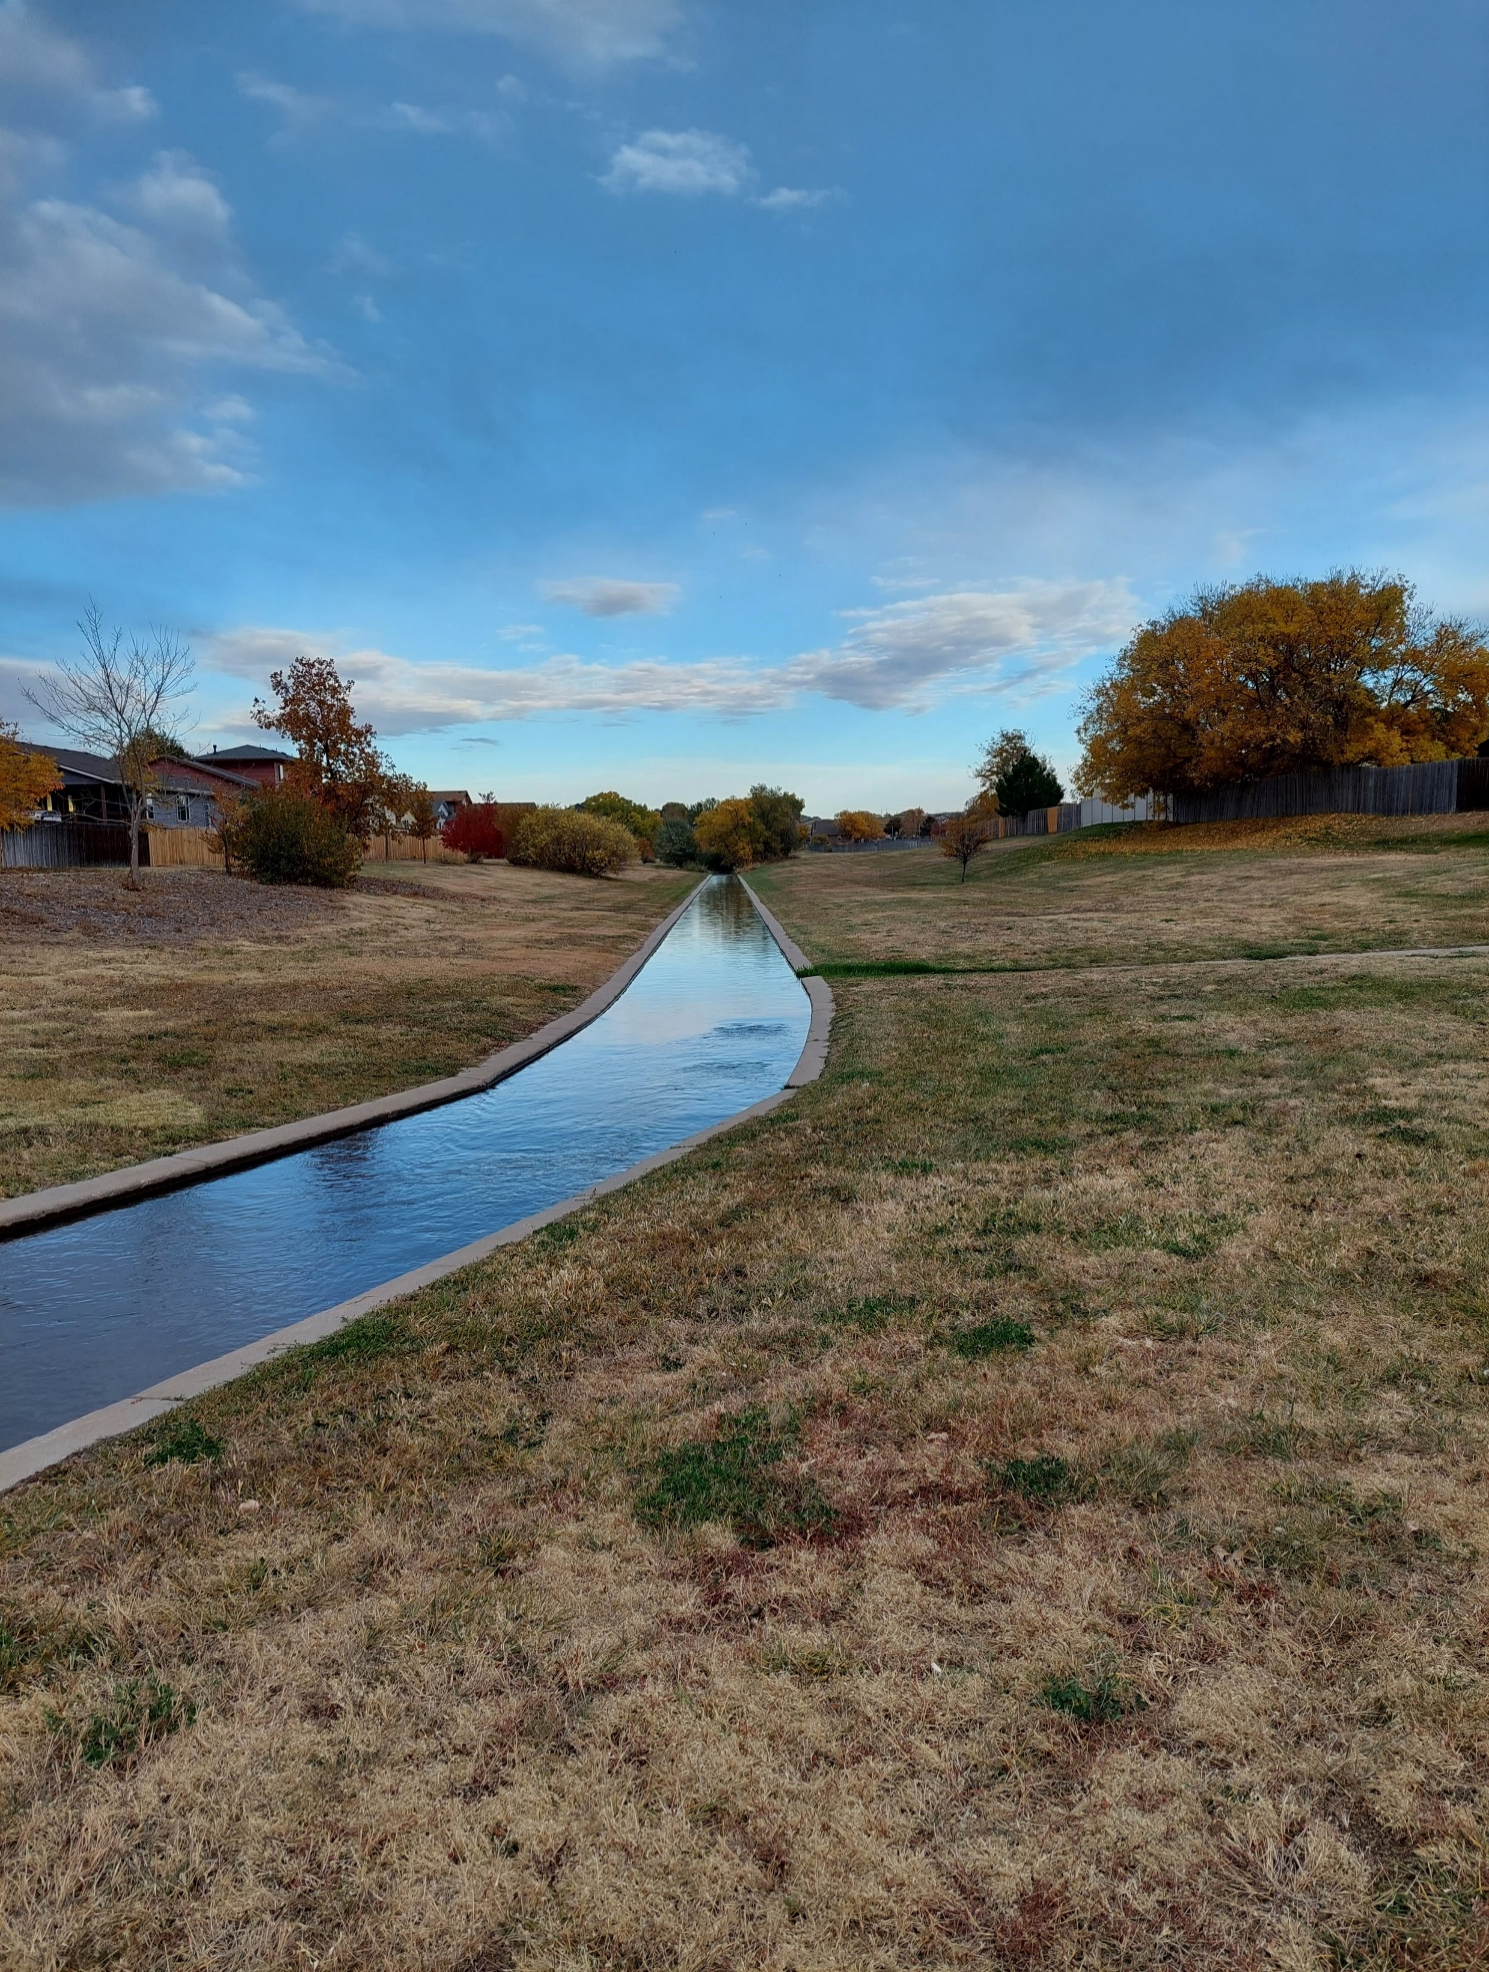
Odds and Ends
Campaign records must be kept for 180 days after the election (LLC affirmations for 1 year).
Candidate committees reporting contributions from their own candidate should select the Contributor type of “Candidate”.
QUESTIONS

Slide 39
THANK YOU
Campaign Finance Compliance & Guidance Support Team
CPFHelp@coloradosos.gov
303-894-2200 x 6383
Campaign Finance Complaints & Enforcement Team
CPFcomplaints@coloradosos.gov
303-894-2200 x 6338

